Slide 1
Name : Sakthimounishwaran A
NM.ID : au730321104044
RegNo : 730321104044
Dept : B.E-CSE
Year : 3rd-year
College : Builders Engineering College

Slide 2
NEXT WORD PREDICTOR
Next word prediction is a technology utilized in natural language processing (NLP) and human-computer interaction. It aims to predict the next word or phrase a user is likely to type or speak based on the context of their input. This predictive capability is commonly integrated into various applications such as virtual keyboards on smartphones, text editors, search engines, and chatbots

Slide 3
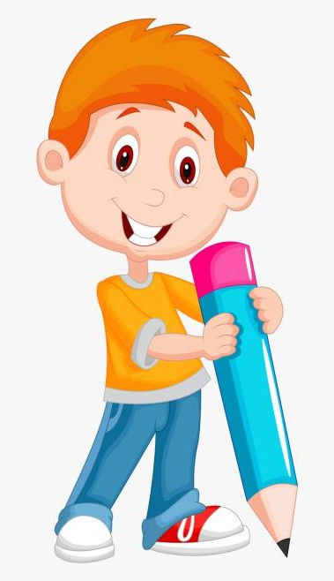

AGENDA
Introduction and Overview
Technologies and Techniques
Implementation and Integration
Benefits of Next Word Prediction
Challenges and Limitations
Future Directions and Innovations
Conclusion
3/21/2024 Annual Review

Slide 4

PROBLEM STATEMENT
The objective of addressing the problem statement for next word prediction is to enhance the accuracy, efficiency, and user experience of predictive text input systems .The predictor should seamlessly integrate into existing text-based applications and provide real-time suggestions to enhance user typing experience.
Key Challenges
Prediction Accuracy
Contextual Understanding
Adaptability and Personalization
Efficiency and Real-Time Processing
Multimodal Input Prediction
Privacy and Data Security

Slide 5
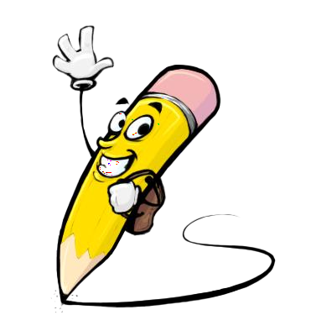
PROJECT OVERVIEW
Next Word Predictor aims to revolutionize text input experiences by accurately predicting the next word or phrase a user intends to type. Leveraging advanced natural language processing (NLP) techniques and machine learning algorithms, the project seeks to enhance typing efficiency, reduce cognitive load, and facilitate faster communication across various text-based applications.
Objectives:
1.Develop a robust next word prediction system capable of accurately anticipating the next word or phrase based on user input.
2.Optimize prediction models for real-time performance and efficient resource utilization across different platforms (e.g., mobile devices, web browsers).
3.Implement strategies for handling out-of-vocabulary words and continuously improving prediction accuracy through user feedback and data-driven approaches.

Slide 6

WHO ARE THE END USERS?
The end users of the Next Word Predictor can vary across different contexts and applications. Here are some examples of potential end users:
Mobile Device Users
Desktop Software Users
People with Disabilities
Language Learners
Professionals
Elderly Users
Students

Slide 7

SOLUTION AND ITS VALUE PROPOSITION
The Next Word Predictor is a cutting-edge predictive text technology designed to anticipate and suggest the next word or phrase as users type. Leveraging advanced natural language processing (NLP) algorithms and machine learning models, our solution revolutionizes text input experiences across various platforms and applications.
Key components:
1.Real-Time Predictive Engine
2.Adaptive Learning Macanism
3.Out-of-vocabulary andling
Value Proposition:
Enhanced Typing Efficiency
Improved User Experience
Increased Productivity
Accessibility and Inclusivity

Slide 8

THE WOW FACTORS:
State-of-the-Art Accuracy: Achieving an exceptionally high accuracy rate in predicting the next word, surpassing existing prediction systems and benchmarks. Utilizing cutting-edge language models, advanced algorithms, and innovative techniques to improve accuracy can be impressive.
Real-Time Adaptation: Implementing a system that dynamically adapts to the user's writing style, preferences, and context in real-time. This could involve sophisticated machine learning algorithms that continuously learn from user input and adjust predictions accordingly.
Multimodal Integration: Developing a next word prediction system that seamlessly integrates with various input modalities such as text, voice, gesture, and touch. Allowing users to switch between input modes while maintaining consistent and accurate predictions can be highly impressive.
Personalization: Providing highly personalized predictions tailored to individual users' preferences, linguistic patterns, and writing styles. Offering a level of personalization that significantly enhances user experience and productivity can be a major wow factor.
Privacy and Security: Implementing robust privacy-preserving techniques to protect user data while still enabling personalized predictions. Ensuring the highest standards of privacy and security in handling user-generated data can be a compelling selling point.
3/21/20

Slide 9
MODELLING
Models:
Simpler models predict based on recent words (n-grams).
RNNs are powerful but struggle with long sequences.
LSTMs excel at capturing long-term dependencies in sequences, making them ideal for next word prediction.
Training:
Large text datasets are used to train the model.
The model learns relationships between words and predicts the next likely word.
Advanced Techniques:
Bidirectional LSTMs consider context from both sides for better predictions.
Smoothing techniques address unseen words in n-gram models.
By leveraging these techniques, NLP can create robust next word prediction models that enhance various applications and user experiences.

Slide 10
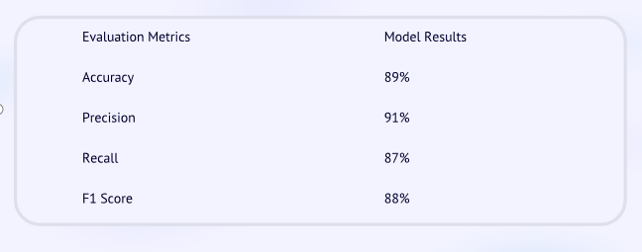
RESULTS

